Slide 1
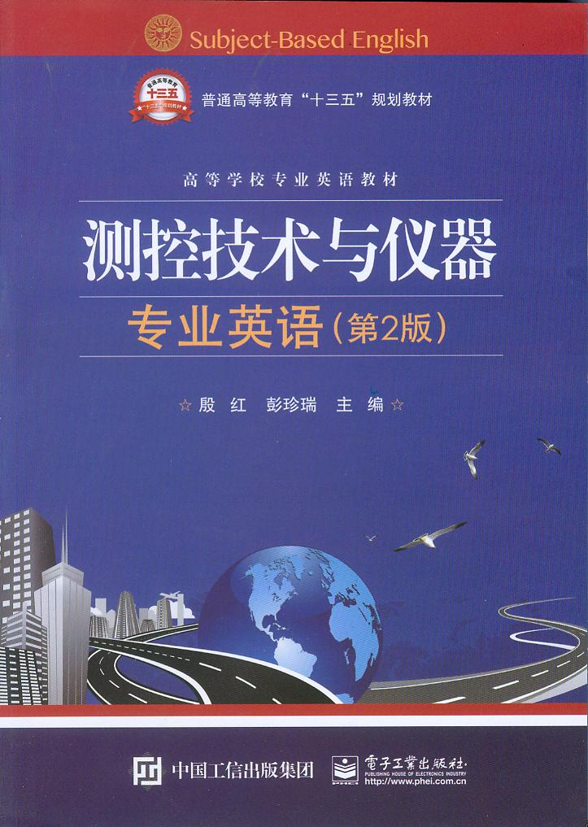
Unit 2 Data Acquisition

Slide 2
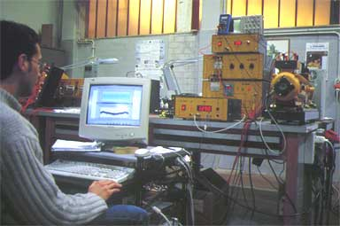
Unit 2 Data Acquisition

Slide 3
However, we define itself to a particular class of data acquisition system, defined as:
An electronic instrument, or group of interconnected electronic hardware items, dedicated to the measurement and quantization of analog signals for digital analysis of processing.
然而，我们为一类特定的数据采集系统给出定义，定义为：
专门用于对模拟信号的数字化处理分析进行测量和量化的电子仪器或相互连接的电子器件组。

Slide 4
Data acquisition system
1.Analog multiplexer模拟多路复用器
2.Signal conditioning信号调理
3.Analog-to-digital (A/D) converter模/数转换器
4.Digital clock数字时钟
5.Manual data entry手动数据输入
6.Digital buffer数字缓存器
7.Output buffer输出缓存器
8.Recording/processing device记录/处理装置

Slide 5
It consists of a series of switches whose inputs are tied to the various analog signals and whose outputs are tied to a common measuring point in a predetermined sequence.
句中are tied to原意为“被绑定于”。
译为：它由一组转换开关组成，其输入是不同的模拟量信号，输出由同一个测点按预置序列给出。

Slide 6
For instance, it is not uncommon to combine amplification with filtering or to find a low-level amplifier before a sample-and-hold.
句中low-level amplifier意为“低电平放大器”，sample-and-hold意为“采样保持技术”。
全句译为：例如，通常将放大和滤波结合起来，或者在采样保持之前先进行低电平放大。

Slide 7
In an ordered sequence, it gathers up such data as the multiplexer channel number, the signal conditioner gain, A/D converter data, manual data, clock information, and discrete events.
在有序序列中，输出缓存器采集的数据有：多路复用器通道号、信号调理增益、A/D转换数据、手动数据、时钟信息以及离散事件等。

Slide 8
External data acquisition systems
1.Real-time data acquisition and control实时数据采集和控制
2.Discrete (bench/rack) Instruments离散（台式/架式）仪表
3.Hybrid data acquisition systems混合数据采集系统

Slide 9
Although Microsoft Windows has become the standard operating system for PC applications, it is a non-deterministic operating system that can’t provide predictable response times in critical measurement and control applications. Therefore, the solution is to link the PC to a system that can operate autonomously and provide rapid, predictable responses to external stimuli.
尽管Windows操作系统在计算机应用中已成为标准操作系统，但是在苛刻的测控应用中，它无法给出预期的响应时间，是个不确定的操作系统。因此，解决的办法是将PC机连入系统，该系统能够自动运行，并对外部激励能快速给出预期响应。

Slide 10
New products such as scanners, multiplexers, counter/timers, nanovolt-meters, micro-ohmmeters, and other specialized instrumentation have made it possible to create computer-controlled test and measurement systems that offer exceptional sensitivity and resolution.
句中sensitivity and resolution意为“灵敏度和分辨率”。
全句译为：扫描仪、多路复用器、计数器/定时器、纳伏表、微欧姆计以及其它专业仪表等新产品使得计算机控制的测试系统有可能提供更高的灵敏度和分辨率。

Slide 11
Hybrid systems are a relatively recent development in external data acquisition systems. A typical hybrid system combines a DMM-type user interface with several standard data acquisition functions and expansion capabilities in a compact, instrument-like package. Typical functions include AC and DC voltage and current measurements, temperature and frequency measurements, event counting, timing, triggering, and process control.
混合系统是外部数据采集系统中相对近期的发展方向。典型的混合系统将数字万用表（DMM）用户接口和几个标准数据采集功能及其扩展功能集成在一个紧凑的仪表包中。典型功能包括：直流和交流电压电流测量，温度和频率测量，事件计数、定时、触发和过程控制。

Slide 12
Analog signal transmission
Today, digital computers and other microprocessor-based devices have replaced analog recording and display technologies in all but the simplest data acquisition applications. And while computers have had an undeniably positive impact on the practice of data acquisition, they speak only a binary language of ones and zeroes.
句中but表示否定，译为：现在，数字计算机和其他基于微处理器的设备代替了所有模拟记录和显示器技术，唯独不能代替最简单的数据采集功能。尽管计算机在数据采集的应用中具有不可否定的积极影响，但他们只讲1和0的二进制语言。

Slide 13
It is the fundamental relationship between voltage, current, and electrical resistance that allow either a continuously varying current or voltage to represent a continuous process variable. While most single-channel analog signal transmissions use direct current (DC) variations in current or voltage to represent a data value, frequency variations of an alternating current (AC) also can be used to communicate information.
是电压、电流和电阻之间的基本关系，使得可以使用连续变化的电流或电压来表示连续过程变量。 虽然大多单通道模拟信号变送器使用电压电流信号中直流信号的变化来表示数据值，但交流信号频率的变化也能用于信息传递。

Slide 14
Digital signal transmission
In contrast to analog transducers（传感器，变频器；变换器）that sense continuous variables such as pressure and temperature, many transducers provide an output that is one of two states: high or low, open or closed. A pressure might be too high or a temperature too low, triggering closure of a switch. Outputs, too, are not strictly analog-solenoid. Valves typically are opened or closed.
模拟变送器感知连续变量，如压力和温度。相比之下，数字变送器得到一个二态输出：高电平或低电平，开或关。压力可以很高或温度很低，以触发开关的闭合。输出也不是严格的模拟电磁阀。阀门通常为开或关状态。

Slide 15
Many pumps and heaters are simply turned on or off. Pulse signals are another form of digital I/O, with one rotation of a turbine（涡轮机） flow meter or tachometer（转速计，流速计） corresponding to a single, countable event. Digital I/O also can be used for parallel communications among plug-in expansion cards, and to generate clock and other timing signals.
许多泵和加热器只是简单地打开或关闭。脉冲信号是数字I/O的另一种形式，随着涡轮流量计或转速计转一圈，对应于一个可数的事件。数字I/O也可用于嵌入式扩展卡的并行通信，产生时钟和其他计时信号。

Slide 16
Similar to analog-to-digital converters used for analog I/O, digital I/O is designed to deal directly with transistor（晶体管）-to-transistor logic (TTL) level voltage changes. TTL typically sets the low voltage level(低电平)between 0 and 0.8V and the high voltage level (高电平) between 2.0 and 5.0V. Voltage levels between 0.8 and 2.0V are not allowed.
类似于模数转换器用于模拟I/O，数字I/O用于直接处理TTL电平变化。TTL通常将0-0.8V置为低电平，将2.0-5.0V置为高电平。电压不允许处于0.8-2.0V之间。

Slide 17
“Gluing” pieces of new and/or existing networks together is becoming more feasible with the use of bridging, routing, and media conversion technologies that link local area, wide area, and industrial networks together.
全句译为：使用桥接、路由和媒体转换技术将新网络和（或）现有网络拼接在一起变得更加可行。这些技术将局域网、广域网和工业网络连接在一起。

